Slide 1
Gates and Wires
CS 0447
Jarrett Billingsley

Slide 2
Class announcements
last day to withdraw is this Friday, 3/8
DO NOT download Logisim from cburch.com
my version is fixed in many, many ways

Slide 3
How ICs are made (a For Fun and Context™ section, don’t study)

Slide 4
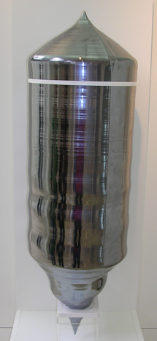
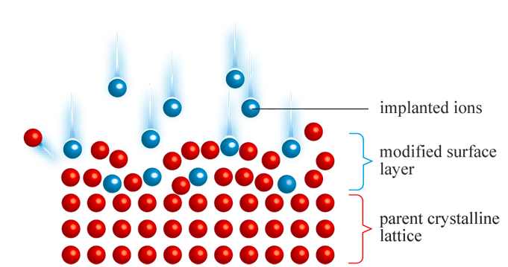
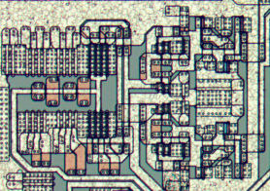
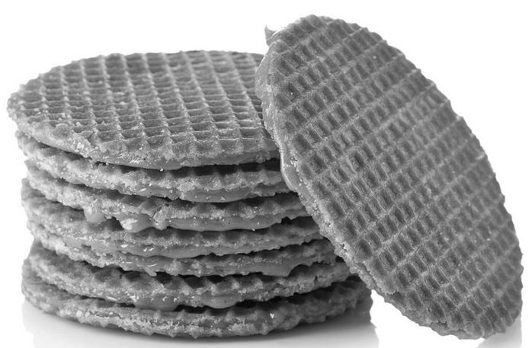
How ICs (integrated circuits) are made
silicon is purified and grown into a monolithic crystal (extremely expensive)
this is sliced thinly to make wafers
gooey caramel is put between them to make stroopwafel
a series of complicated photochemical processes do things like:
change its electrical properties
make wires to connect things
make inert insulating layers
Notes:
- silicon is a semiconductor – by default, it's somewhere between conductor and insulator.
- it can be "nudged" towards one or the other by either changing it physically (stuffing boron or phosphorous atoms in between the silicon ones) or by applying electrical fields/currents
- it's this property that lets us build switches with zero moving parts.
- there are many semiconductor materials, but silicon is (currently) the one we build most stuff out of.

Slide 5
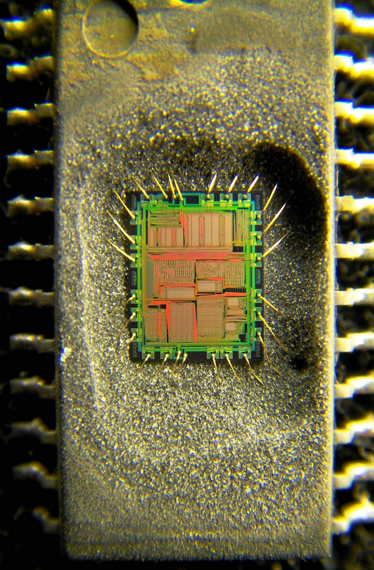
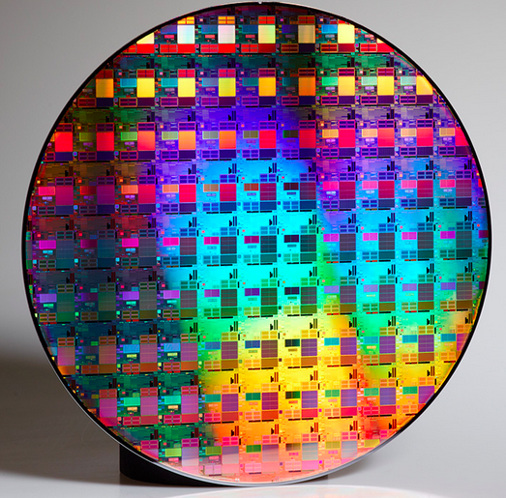
How ICs (integrated circuits) are made
many ICs are printed on one wafer
the wafers are diced (chopped up)
the ICs are tested
the ICs are mounted in a package ->
they're tested again
then they're ready to sell
Notes:
- yes, they print rectangular chips on a round wafer. yes, this means there are partial chips on the edges.
- they just recycle the silicon into the next crystal.
- "then why not grow a rectangular crystal?" cause it's way harder than growing a round one!

Slide 6
Manufacturing yield
ICs are tiny and complex
silicon crystals can have defects
a tiny speck of dust during production can ruin an entire chip
the yield is the percentage of usable chips
bigger chips have smaller yields: more opportunities for mistakes
but smaller chips can be rendered useless by tiny mistakes, too!
the size of the silicon is the biggest factor in the price of an IC
huge ICs (several cm on each side!), such as very high-resolution camera sensors, can cost thousands of dollars!
the tiniest ICs are like… the size of a grain of sand and cost cents
manufacturers can also bin resulting chips
bug-free ones can be sold as Core i9s and i7s for lotsa money
slightly malformed ones can be sold as Core i5s and i3s
and the ones they sweep off the floor are the Celerons

Slide 7
The fundamental unit: Transistors
a transistor is an electrically-controlled switch
the input, output, and control are all single bits
the bits are represented as voltages (maybe 3.3V = 1, 0V = 0)
input
input
control
control
now just put 3 billion of them together! who said EE was hard?
output
output
it connects its input to its output if control is a 1.
this one connects its input to its output if control is a 0.
Notes:
- ;))))))))))))))))))))

Slide 8
Infinite diversity… in infinite combinations (animated)
from these switches, we build… everything.
1
when A = 1, the top switch is open and the bottom switch is closed, so Y = 0.
A
Y
0
when A = 0, the top switch is closed and the bottom switch is open, so Y = 1.
1
1
0
what boolean function is this?
0
Notes:
- it's a boolean NOT!

Slide 9
Schematics Okay, start studying here!

Slide 10
From writing to drawing
a schematic is a graphical way to represent systems.
for example, flowcharts are a schematic way of describing an algorithm or program.
"real" hardware design is done with HDLs (hardware description languages (text)) and EDA (electronic design automation (schematics))
but schematics and text are equal in descriptive power. so, we're not just playing around when we learn this stuff.
Notes:
- maybe you've programmed schematically before, if you used Scratch or something similar!
- text and graphics have their own advantages and disadvantages, and sometimes it's best to use a combination of both
- a graphical description of a system is often easier to understand at a glance
- graphics are two- or three-dimensional; text is one-dimensional
- text can be a lot more terse for small or repetitive tasks
- text is easier to work with for people with visual disabilities

Slide 11
Go with the flow
rather than showing an explicit sequence of steps, circuit schematics show how data flows from one component to another.
components can consume values…
components can produce values…
A
0001
+
B
0101
and components can do both.
the connections between them are the wires – they connect the producers to the consumers.
Notes:
- the wires do not have arrows on them because there is no implied directionality.
- data flows from the producers to the consumers because it must.
- also, the direction of the data flowing through the wires can change over time.
- inputs tend to be on the left, and outputs tend to be on the right. that way, data flows left-to-right through the circuit.
- tend to be. it's just a convention, and we can break that convention.
- here we have LEDs whose inputs are on the bottom.

Slide 12
Everything happens so much
there is no implied "order" when you make a circuit schematic.
everything in the circuit happens simultaneously.*
+
if I have 4 adder components next to each other, then I am doing 4 additions in parallel – at the same time.
+
this is likely a totally different way of thinking than you are used to.
+
unless you've been doing a lot of multithreaded programming which seems unlikely
+
soon, we'll look at sequential circuits, which can make things change over time.
Notes:
* ok yeah there's no such thing as "simultaneously," everything takes time, so there is some concept of order.
- but everything in the circuit is Doing Its Thing all the time, in parallel. this is totally different from a flowchart.

Slide 13
Boolean Functions and Gates

Slide 14
Boolean functions and truth tables
a Boolean function takes one or more Boolean (true/false) inputs and produces a Boolean output.
a truth table summarizes a Boolean function by listing the output for every possible combination of inputs.
A | Y
F | T
T | F
A | Y
0 | 1
1 | 0
if you’re in a logic course, these values are represented by T and F…
…but digital logic uses 0 and 1 instead.
(what Boolean function is this?)
Notes:
- if you don’t know the answer to that question by now…

Slide 15
Boolean logic formalisms
when it comes to writing out Boolean functions, things get… tricky
“A and B, or not C” could be written:
(A && B) || !C
(A & B) | ~C
(A ∧ B) ∨ ¬C
AB + C
this is how logicians and mathematicians usually write it;
this is how computer engineers usually write it;
and C-style languages have two ways to write it!
since we’re doing digital logic, we’ll be using this middle formalism: adjacent variables for “AND”, + for “OR”, and overbars for ”NOT”.
Notes:
- the ”bar over C” in the middle one is so hard to get looking right on all platforms, aghhglhgl

Slide 16
Gates
a gate implements one of the basic Boolean logic functions.
let's start with the simplest: the NOT gate.
A is the input
Y is the output
A
Y
this little bubble means "NOT"
the convention in circuit schematics is that data flows left to right (but that definitely isn’t always true)
Notes:
- why do we use Y?? Y, indeed…. ;))))))))))))))))

Slide 17
AND, OR, and… XOR?
we know about AND and OR, but what's XOR?
A
A
A
Y
Y
Y
B
B
B
AND gate
OR gate
XOR gate
A | B | Y
0 | 0 | 0
0 | 1 | 0
1 | 0 | 0
1 | 1 | 1
A | B | Y
0 | 0 | 0
0 | 1 | 1
1 | 0 | 1
1 | 1 | 1
A | B | Y
0 | 0 | 0
0 | 1 | 1
1 | 0 | 1
1 | 1 | 0
eXclusive OR means "one or the other, but NOT BOTH.”
you get a 1 when the inputs differ.
Notes:
- in most programming languages, bitwise XOR is written A^B
- that is NOT "to the power of", it's exclusive OR.
- as far as I know, only calculators use ^ to mean exponents.

Slide 18
If you give an electrical engineer a NAND gate…
if you stick a NOT gate after an AND gate, you get a NAND gate
this kind of gate has a cool property: it's universal
that means you can make any boolean function with NAND gates
~A = A NAND A
A & B = ~(A NAND B)
etc… (no you do not have to remember these)
you can build an entire computer with NANDs
digital logic courses use them cause NAND gate chips are cheap
but in Logisim, we have infinite gates for free :D
Notes:
- there are also NOR gates and XNOR gates, and you can guess what they are.
- there are some low-level reasons why NAND is preferred in some cases, but all the literature I can find seems to say that modern circuit design just uses "whatever is needed" in most cases
- the hardware designers today are likely working a few levels of abstraction above "picking individual gates" in most cases anyway

Slide 19
Solving some simple problems with gates
for these, let’s take a minute or so talking to each other to come up with a combination of one or two gates to solve the problem.
remember that 1 = true = yes, and 0 = false = no, and feel free to look back at the truth tables a few slides back
so:
a circuit that tells you if its input is 0 (historically, people really overcomplicate this)
a circuit with two inputs (two Boolean values) and tells you if they are equal/the same
a circuit with three inputs that tells you if any of them are 1
how would you modify that to make it tell you if all of the inputs are 0?
where might this be useful?
Notes:
- sorry, no solutions down here… if you’re studying this and aren’t sure about your answers, come ask me or a TA for help!

Slide 20
Inputs, Outputs, and Wires (in Logisim) (we won’t do these slides in class, but you can refer to them for lab 5)

Slide 21
Logisim's Inputs and Outputs
to interact with our schematics, Logisim gives us these.
Inputs have square corners.
this little dot is the pin that you can attach wires to.
0
you can use the hand tool 👆 to change their value to interact with your circuit.
they show a value that you give them. (this one isn't being given a value, so it shows x.)
Outputs are round, or have rounded corners.
x
do not confuse inputs and outputs! they have totally different purposes.
Notes:
- it's just a really really common mistake so I have to mention it

Slide 22
Other kinds of inputs and outputs
some really common ones I'll use in examples and such:
a button is an input that normally produces 0, but produces a 1 when you push 👆 it.
an LED (light-emitting diode) is an output that is normally dark, but lights up when you give it a 1.
-
probes look like outputs, but they're more like a "debug print" for inspecting values. they are not the same as outputs, though.
13
they can display their value in different bases (or “radixes,” as Logisim calls bases).
d

Slide 23
What's a wire?
say you wanna do Y = AB + C i.e. (A && B) || C
so we need an AND gate…
A
and an OR gate…
B
and then hook them together like this.
Y
C
wires transport values from producers to consumers. this happens "instantly."
Notes:
- nothing actually happens instantly in real life. but this is schematic land!

Slide 24
Logisim's wire colors
Logisim colors wires according to their kind and state.
green means
1-bit.
black means
multi-bit.
blue means
"X."
red means "error."
orange means size mismatch.
1
8
1
0
X is neither 1 nor 0. blue is bad. avoid these.
you have a bug.
you have… a different bug.
Notes:
- black wires are multi-bit wires, which we won't talk about until next time.
- blue is actually really useful in some cases, but not actually needed for anything we'll talk about in this course.
- it's tied to the concept of "wires where the direction can change over time"…
- it's a way for multiple producers to share one wire, which is normally a Bad Thing that causes red wires.
- grey wires are unconnected to anything… just delete em.

Slide 25
What causes red error wires?
very often, it's this.
you cannot connect two outputs together with a wire.
what if one gate outputs 1 and the other outputs 0?
IRL this would cause the value to be "indeterminate."
or your gates would blow up
another really common possibility: you didn't hook anything up to one or more of a component's inputs.
Notes:
- you can't have two producers producing different values onto the same wire.
- unfortunately, Logisim doesn't simulate the release of Magic Smoke
- what does it mean to AND nothing with nothing?

Slide 26
But this is totally OK
you can connect one wire to as many inputs as you want.
the little circle means these wires are connected together.
this way one producer can send its value to any number of consumers.
they all "see" the same value at the same time.

Slide 27
Tunnel time
a tunnel is a named wire; it lets you connect things long-distance.
one
one
the name of the tunnel is what's important.
any tunnels of the same name are "virtually" connected.
you can have as many copies of the tunnel as you like.
one
tunnels are your main way to avoid spaghetti circuits. use them!
Notes:
- learn to copy and paste things without right-clicking. it saves a lot of time.

Slide 28
What is real?
do Logisim's components represent real-world objects?
some of them, sure.
but schematics are an abstraction, like programming languages.
e.g. tunnels are a convenient way to tidy up your circuit, but you can't magically teleport signals across space in real life.
radio communication is not magic and requires a lot of stuff to make it happen IRL
real circuit design software translates these high-level abstractions into real, buildable circuits for you, in much the same way that HLL compilers translate stuff into assembly/machine code.
Notes:
- there is actually a popular fork of Logisim that can turn a limited set of circuits into HDL code, which can then be “compiled” into either a bitstream for an FPGA (a kind of reprogrammable hardware), or a real honest-to-god integrated circuit design.

